Slide 1

Investigating Complaints
PATIENT RELATIONS – UNIVERSITY HOSPITALS BIRMINGHAM
Richard.Lodder@uhb.nhs.uk
Patient Relations - Training
A comprehensive best practice guide to handling complaints within University Hospitals Birmingham
Notes:
“Before we start, let’s have a show of hands if you have received or handled a complaint recently” “If you have, how did you find the experience and the process?”

Slide 2
Learning Objectives
PATIENT RELATIONS – UNIVERSITY HOSPITALS BIRMINGHAM
This session aims to ensure:
You are familiar with the main regulations that govern complaint handling
You are aware of the relationship between early de-escalation, PALS, formal complaints, reopened Complaints, and PHSO cases
You are familiar with the tiered response framework and the associated timeframes
You are aware of the legal and regulatory considerations regarding complaints in the NHS
You understand what effective complaint handling is, and your potential role(s) in complaints investigations, including the types of evidence gathering expected
You are familiar with the complaints learning action plan and its purpose as a continuous improvement tool
The role of leadership in creating and maintaining a culture of openness and continual learning
Notes:
“Before we start, let’s have a show of hands if you have received or handled a complaint recently” “If you have, how did you find the experience and the process?”
These are the main learning objectives of this training. This training does not provide a detailed coverage of the PALS or Complaints process as this is covered in another session. This session also does not cover specifics relating to Information Governance, such as staff being recorded by patients, families, carers, or advocates. If you have queries regarding this, please direct them to the Information Governance Team.

Slide 3
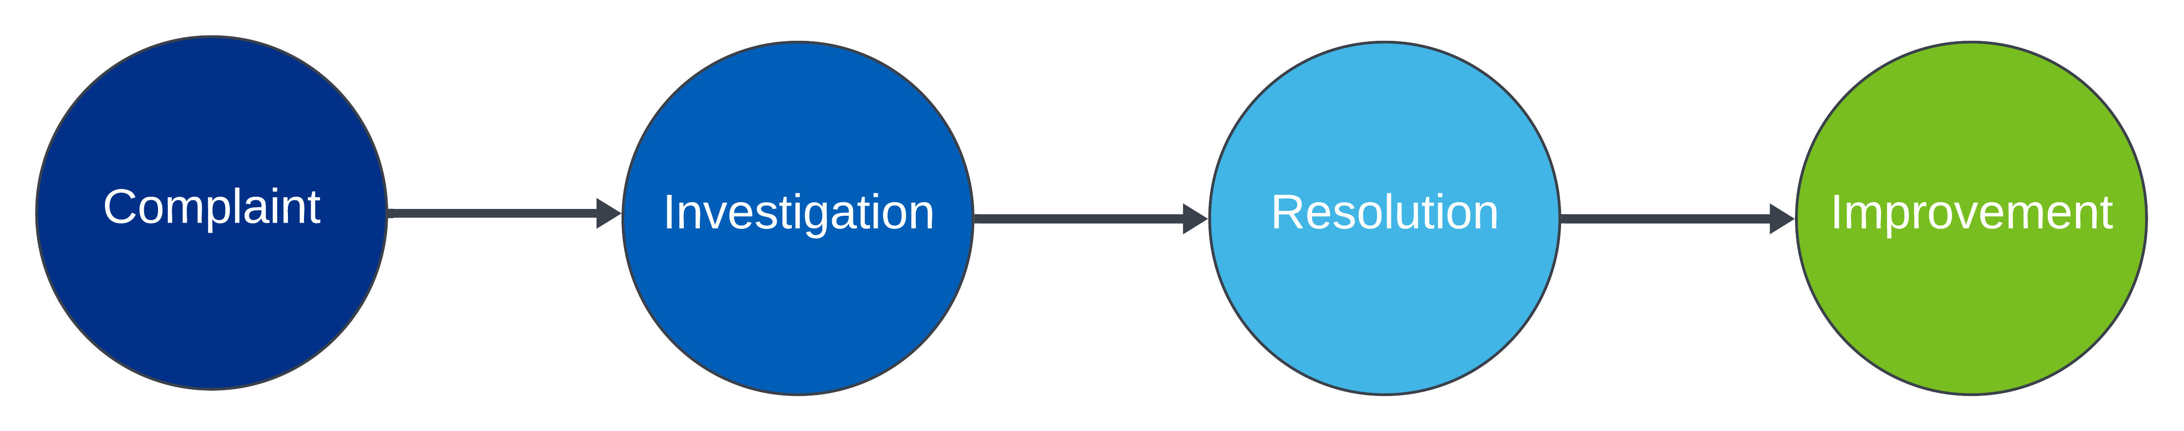
1. Introduction
Why complaints matter:
Well-handled complaints boost patient trust and improve services. Patients who feel heard and valued are more likely to trust healthcare providers and continue seeking care. Addressing complaints positively can lead to identifying and resolving systemic issues, improving overall service quality.
How to do it right:
Follow key frameworks, regulations, and guidance. And, of course, attend this training!
Research has shown that systematic complaint analysis can reveal "hot spots" of problematic care and "blind spots" in service provision, which, if addressed, can significantly improve patient safety and overall healthcare outcomes​.
1. https://www.lse.ac.uk/Research/research-impact-case-studies/2021/analysing-and-learning-from-healthcare-complaints
Notes:
On a scale of 1 – 10 how confident would you feel handling a complaint that lands in your inbox today, and why?

Slide 4
2. Key Regulations
NHS Complaint Regulations (2009):
These regulations set the framework for who can make a complaint, the timeframes for handling complaints, and the responsibilities of NHS bodies in the complaint process.
PHSO Guidelines:
The Parliamentary and Health Service Ombudsman provides six key principles for handling complaints, emphasising fairness, transparency, and continuous improvement.
Legal Considerations:
The Duty of Candour, GDPR, and the Equality Act 2010 are not just legal frameworks but critical ones that ensure complaint investigations are conducted transparently and protect patient rights.
NHS Complaints Regulations
PHSO Guidelines
Other Regulatory and Legislative
Practical Skills

Slide 5
3. Overview of NHS Complaint Regulations 2009
Who can complain
Anyone who has received NHS services or is affected by the actions of an NHS body.
Including representatives for anyone incapacitated or deceased.
Timeframes
Resolution: The national recommendation is within 6 months. UHB’s limit is 65 working days.
To make a complaint: There is a 12-month window for making a complaint with some exceptions.
Other
Complaints must be acknowledged within three working days.
We should aim to resolve complaints at a local level.
Complainants can escalate complaints to the PHSO if their concerns are unresolved.

Slide 6
4a. UHB Complaints Process
Early De-escalation (Local Resolution): The first step
is to resolve issues informally through direct and open communication with the complainant at a local level.
PALS (Patient Advice and Liaison Service): If early resolution isn’t possible, PALS can assist, particularly with immediate or ongoing issues such as appointments or administrative concerns.
Formal Complaint: When issues persist, the complaint enters the formal process, which includes acknowledgement, investigation, and response. This step ensures thorough handling of the complaint.
Follow-Up Complaint: If the complainant remains dissatisfied with the resolution, a follow-up can be initiated to address any unresolved aspects (up to 4 times).
PHSO (Parliamentary and Health Service Ombudsman): As a final step, if the complainant is still unhappy with the outcome, the complaint can be escalated to the PHSO for independent review and possible further action.
Early De-escalation
(local resolution)
PALS
Formal Complaint
Follow-Up Complaint
PHSO
Notes:
Lets just pause for a moment. “If you had to write the perfect one-line complaint response, what would it say and why?”
We should aim to de-escalate locally where possible, this is the easiest and quickest way of managing someone’s concerns without entering into a lengthy complaint process/investigation.

Slide 7
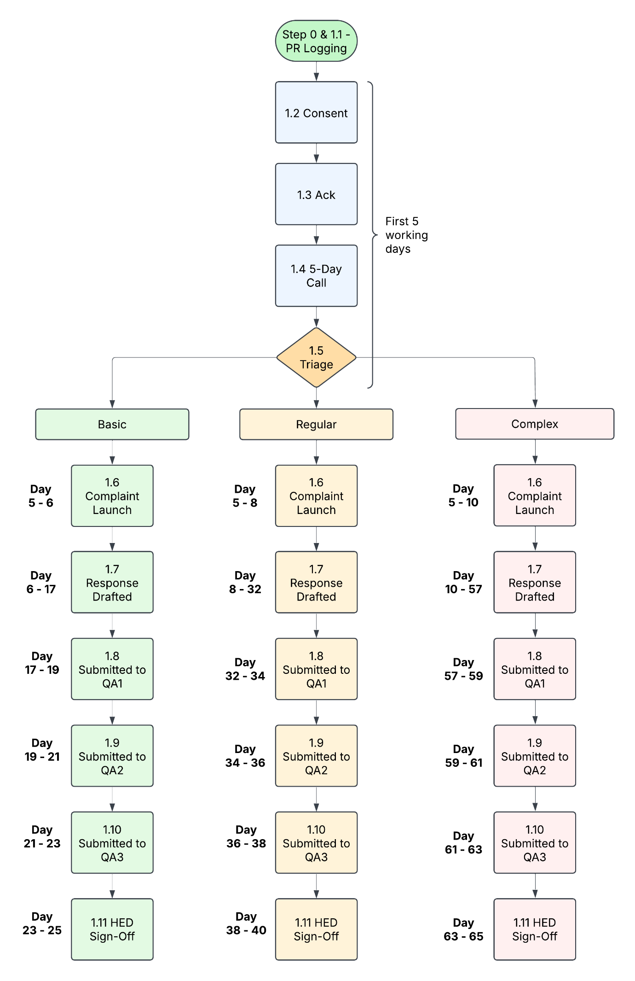
4b. UHB Complaints Process
The infographic below outlines the key stages of the complaint investigation process and the corresponding timeframes for each stage.
Day 1 – 3
Day 4 - 5
Day
25 - 35
Notes:
Explain that all complaints follow the same process until triage, then the timeframe for launching and responding to the complaint varies based on whether it is Basic (25 days), Regular (40 days), or Complex (65 days). Each QA step is 2 days regardless of the complexity.

Slide 8
4c. UHB Complaints Process & Group Work
The infographic below outlines the key stages of the complaint investigation process and the corresponding timeframes for each stage.
Day 1 – 3
Day 4 - 5
Day
25 - 35
Notes:
For this slide we will pause for group session #1

Slide 9
5. PHSO Guidelines – 6 Principles
1
Getting it Right
2
Being Customer Focussed
3
4
Being Open & Accountable
Acting Fair & Appropriately
5
Putting Things Right
6
Seeking Continuous Improvement
Ensure decisions are based on comprehensive and accurate information, adhering to
relevant policies and procedures. We should aim to deliver consistent and correct
outcomes for every complaint.
Prioritise the complainant's needs by actively listening and understanding their concerns.
The focus should be on providing a compassionate and responsive service that addresses their situation.
Maintain transparency throughout the complaint process by clearly communicating actions and decisions to the complainant. Accountability means owning up to mistakes and ensuring the process is visible and understandable.
Address all aspects of a complaint impartially, ensuring that responses are balanced and unbiased. Ensure the actions taken are proportionate to the
issue raised.
Where possible, offer remedies or apologies to address the harm caused. This emphasises
the importance of restoring trust.
Use feedback from complaints to identify systemic issues and drive improvements in
service delivery. Learning from complaints helps prevent future occurrences and
enhances overall quality.

Slide 10



6a. Techniques for Investigation
Interviews
Documentation
Planning
Planning the Investigation
Clearly outline the investigation’s scope and goals. Determine the types of evidence needed, such as medical records, staff statements, and relevant policies.
Conducting Interviews
Develop a list of key questions and gather relevant background information before the interview. Use open-ended questions to encourage detailed responses and avoid leading the interviewee.
Documenting the Investigation
Ensure all notes, statements, and evidence are documented accurately and systematically. Summarise findings in a clear, concise report, providing you with a comprehensive understanding of the evidence and the conclusions' rationale.

Slide 11
6b. Techniques for Investigation – Types of Evidence
Staff Statements
Medical Records
Policies & Procedures
Digital Evidence
Physical Evidence
Witness Accounts
Complaint Records
Gather written or verbal accounts from the staff involved to provide direct insights into the actions and decisions taken.
Collect relevant patient records such as treatment logs, medication charts, or care plans to verify claims about clinical care and provide a factual basis for the complaint.
Review the policies and guidelines relevant to the complaint to ensure that actions were taken in line with policies and procedures and to identify potential gaps in policies.
Review any digital records, such as emails, system logs (e.g., patient booking systems), or electronic care notes to provide timestamps and records of interactions or system use.
Collect video footage if available (e.g., for incidents that occur in monitored areas) to provide visual confirmation of events and interactions.
Include statements from witnesses (e.g., other patients or healthcare professionals present) to assess whether they corroborate with or contradict the primary complaint.
Review any prior complaint submission, follow-up comms, and historical complaints for patterns to ensure all issues raised by the complainant have been addressed.

Slide 12




7. Legal and Regulatory Considerations
Duty of Candour
Data Protection& GDPR
Equality Act 2010
Human Rights Act 1998
A legal requirement for openness and honesty with patients when care goes wrong, it is critical for maintaining transparency during investigations.
Ensure GDPR compliance when handling sensitive personal data during investigations and protect the complainant’s privacy.
Mandates non-discriminatory practices in complaint investigations. Ensures all complaints are treated impartially.
Ensures the respect and protection of patient and staff rights throughout the complaint process.

Slide 13





8. Handling Complex and Serious Complaints
Serious Incidents
Identifying Serious Incidents:
Highlight when a complaint overlaps with a serious incident. Serious Incidents typically include events that cause significant harm, unexpected deaths, or cases that raise major concerns regarding patient safety.
Coordination:
Aligning complaint investigations with serious incident reviews is crucial to ensuring consistency and informing the complainant. This alignment can be achieved by assigning a lead investigator, maintaining regular team communication, and synchronising timelines to ensure integrated and consistent findings across both processes.
Multi-Agency Complaints
Establish Clear Communication Channels:
Create structured communication pathways between all involved agencies, ensuring that information is shared promptly and accurately to avoid misunderstandings and maintain a unified investigation approach.
Designate Lead Coordination Roles:
Assign a lead coordinator from one of the agencies to oversee the entire complaint process, ensuring that all organisations understand their roles and responsibilities and that the investigation proceeds smoothly and efficiently.

Slide 14
9. Real World Examples of Complaint Handling
Serious Incidents
Identifying Serious Incidents:
Highlight when a complaint overlaps with a serious incident. Serious Incidents typically include events that cause significant harm, unexpected deaths, or cases that raise major concerns regarding patient safety.
Coordination:
Aligning complaint investigations with serious incident reviews is crucial to ensuring consistency and informing the complainant. This alignment can be achieved by assigning a lead investigator, maintaining regular team communication, and synchronising timelines to ensure integrated and consistent findings across both processes.
Multi-Agency Complaints
Establish Clear Communication Channels:
Create structured communication pathways between all involved agencies, ensuring that information is shared promptly and accurately to avoid misunderstandings and maintain a unified investigation approach.
Designate Lead Coordination Roles:
Assign a lead coordinator from one of the agencies to oversee the entire complaint process, ensuring that all organisations understand their roles and responsibilities and that the investigation proceeds smoothly and efficiently.

Slide 15





10. Communicating with the Complainant
Listen carefully to the complainant’s concerns, showing empathy and understanding. Ensure that they feel heard and valued throughout the process.
Establishing Initial Contact
Active Listening
Providing Regular Updates
Clear and Transparent Communication
Offering Resolution and Next Steps
Notes:
If one of your family members complained about care they had received, what would you hope the process would look like?

Slide 16




11a. Learning from Complainants
Why We Must Learn from Complaints
How We Learn from Complaints
Actions should be specific, measurable, and realistic.
Weak Action: Issuing a general reminder to staff.
Medium Action: Providing training to the team involved.
Strong Action: Revamping the process with new protocols and ongoing monitoring to ensure compliance.
Learning from complaints is essential for improving service quality, preventing repeat issues, and building patient trust. It turns negative experiences into opportunities for positive change.
Benefits of Learning from Complaints
Risks of Not Learning
Enhances patient safety, drives continuous improvement, and strengthens accountability within the organisation.
Failing to learn from complaints can lead to repeated mistakes, diminished patient trust, and potential harm to patients and staff.
Notes:
What do you think most complaints are really about?

Slide 17






11b. Learning from Complainants – Fishbone Analysis
Cause 1
Cause 2
Cause 3
Reason
Reason
Reason
Reason
Reason
Reason
Reason
Reason
Reason
Problem
Reason
Reason
Reason
Reason
Reason
Reason
Reason
Reason
Reason
Cause 4
Cause 5
Cause 6
Notes:
What gets in the way of resolving complaints well in your service?

Slide 18




11c. Learning from Complainants – Feedback Loop
Gather insights from complaints, incidents, and other sources of feedback from patients and staff.
.
.
.
.
.
Monitor the impact of changes regularly and review outcomes to ensure that improvements are effective and sustained. Gather further feedback to restart the cycle.
Use tools like 5 Why’s & Fishbone Diagrams to identify
patterns, causes,
and areas that require improvement.
Create targeted, actionable plans
to address the identified issues, ensuring they are specific, measurable, and achievable.
Put the developed action plans into practice, making necessary changes to processes, policies, or training.
Notes:
What is one thing you’ve done (or seen done) that genuinely helped a complaint get resolved faster or better?

Slide 19
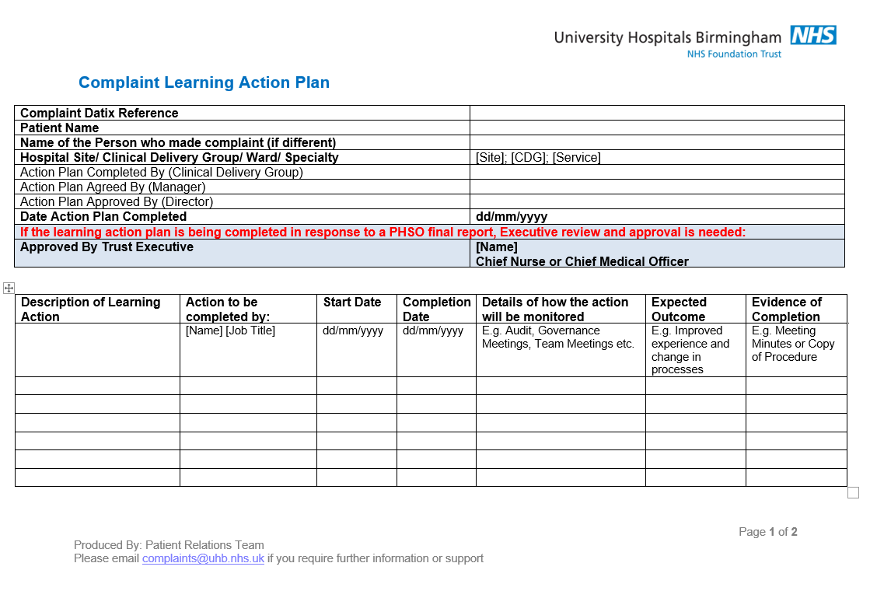
11d. Learning from Complainants – Action Plans
Notes:
If we wanted to reduce complaints by 20% next year, where would you start?

Slide 20
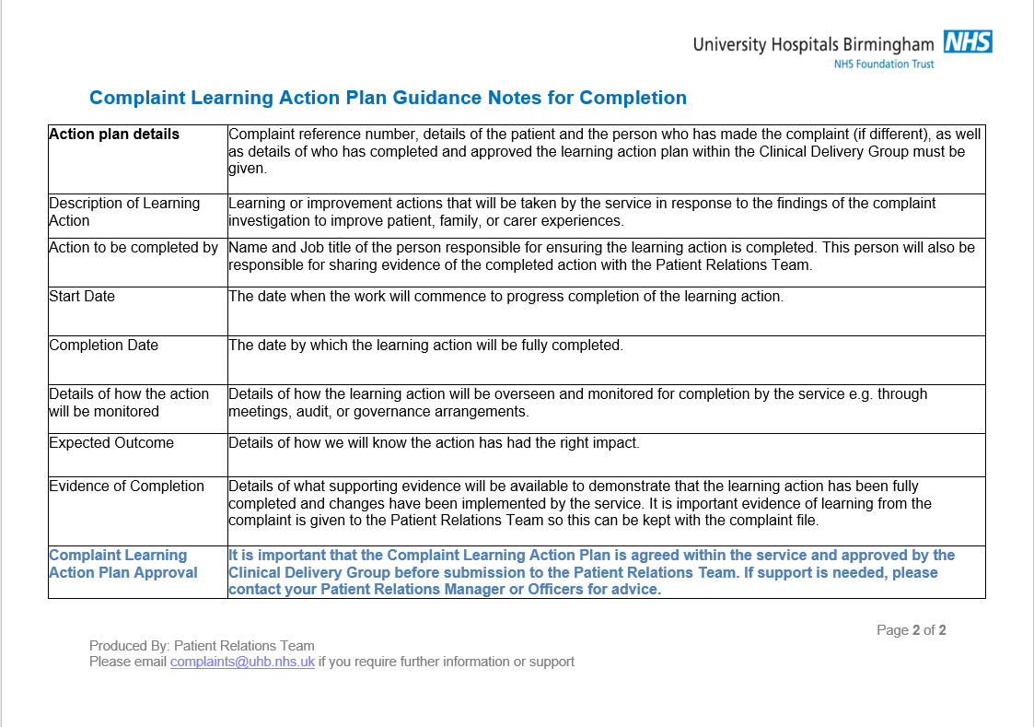
11e. Learning from Complainants – Action Plans

Slide 21



12. The Role of Leadership in Complaint Management
Senior management must ensure a culture that encourages openness and continuous learning, supports staff in complaint investigations, and holds them accountable for the outcomes.
Cultivating a Culture of Learning and Openness
Supporting and Empowering Staff
Provide ongoing training and development opportunities to ensure staff are equipped with up-to-date knowledge and skills for effective complaint handling.
CDG leadership is responsible for ensuring that once complaints have been launched, they are handled promptly, efficiently, and accurately, with completed action plans and factual, empathetic responses delivered within the designated timeframe.
Accountability and Timeliness
Notes:
What would make it easier for you to play your part well in complaint handling?

Slide 22
13. Case Studies and Group Discussion
Questions & Answers
We’ve covered a lot today!
Now is the time to ask any questions you may have about the content we discussed.
Feel free to share scenarios or examples.
Let’s address any uncertainties or challenges you might face when handling complaints.
No question is too small; your input is valuable!
If you have any queries or concerns relating to investigating complaints, or anything to do with the PALS and Complaints processes, please contact Richard Lodder, Patient Relations Quality and Performance Manager Richard.Lodder@uhb.nhs.uk / 0121 371 4617 / 0121 424 0941
Notes:
On a scale of 1 – 10 how confident would you feel handling a complaint after receiving this training?

